Slide 1
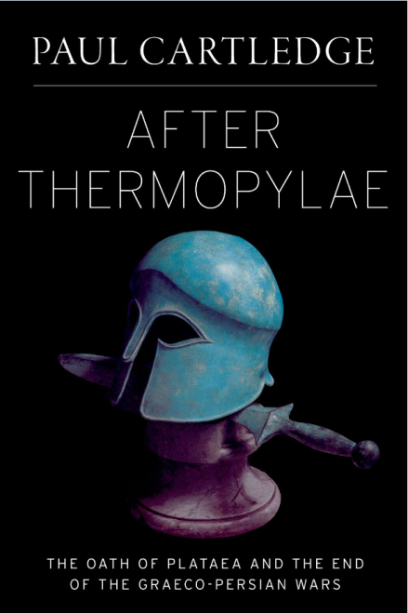
After Thermopylae The Oath of Plataea and the End of the Graeco-Persian Wars
Paul Cartledge
Oxford University Press
June 2013

Slide 2
The Aegean Greek World in the Classical Period From Cartledge, Ancient Greece (2009)

Slide 3
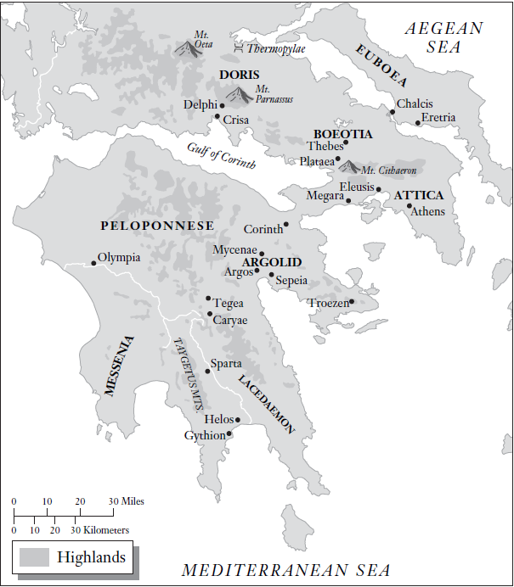
Central and southern mainland Greece After Holland, Persian Fire (2007).

Slide 4
The Persian Empire From Bang and Scheidel, The Oxford Handbook of the State in the Ancient Near East and Mediterraena (2013).

Slide 5
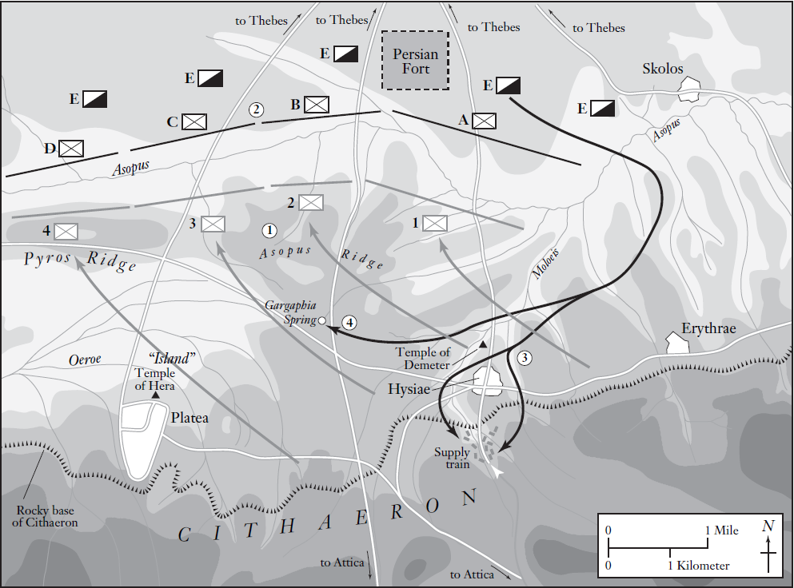
Sketch map of the Plataea Battle After Shepherd, Plataea 479 BC (2012).

Slide 6
The stele dedicated at ancient Acharnae by the priest of Ares bearing the Oath of Plataea and the Oath of the Ephebes Photo courtesy of the École française d’Athènes

Slide 7
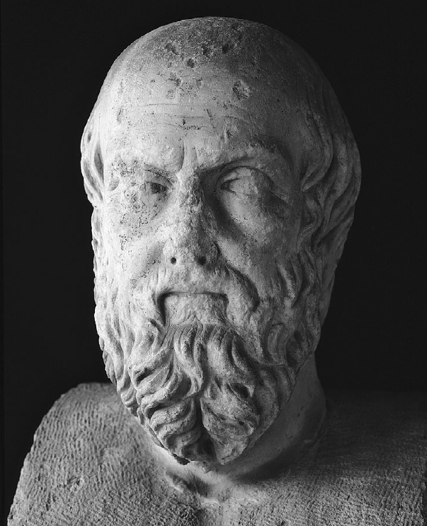
A non-veristic idealized image of the 'Father of History', Herodotus, whose Histories ('Researches') is the ultimate basis of any subsequent account of the Graeco-Persian Wars . Gianni Dagli Orti / The Art Archive at Art Resource, NY

Slide 8
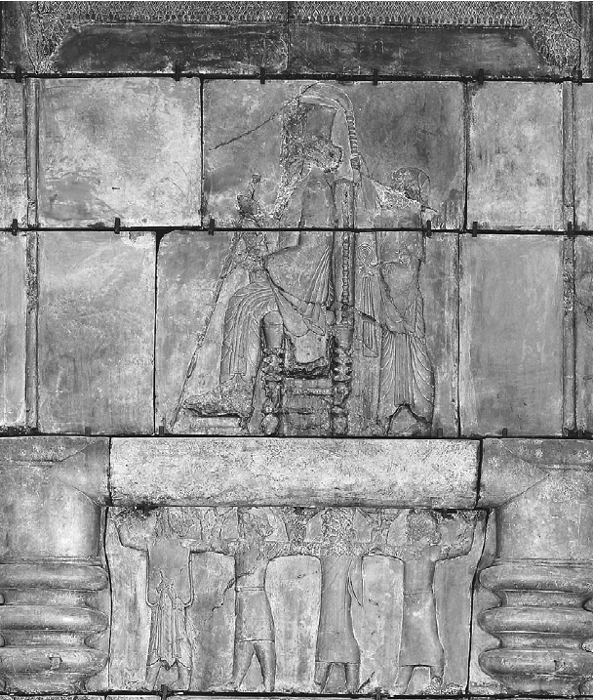
The Great King of Persia (Darius I) enthroned at his palace of Persepolis, Iran, c. 515 bce © The Trustees of the British Museum.

Slide 9
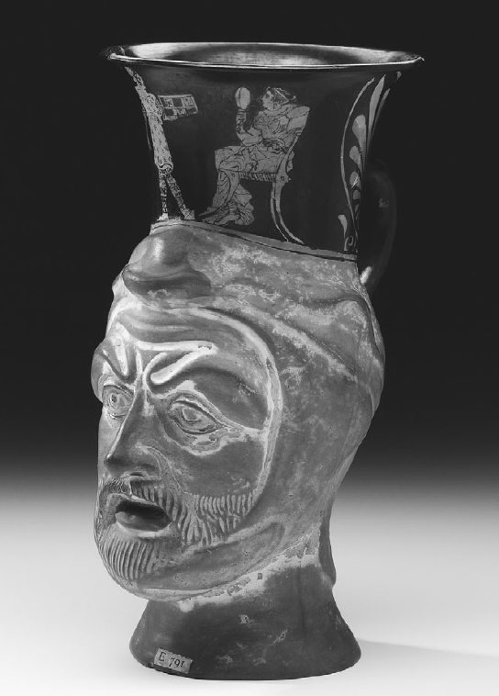
An Athenian lady with her oriental servant surmounts the moulded head of a bearded Persian warrior; Attic red-figure jug c. 410-400, from Nola, Italy. © The Trustees of the British Museum

Slide 10
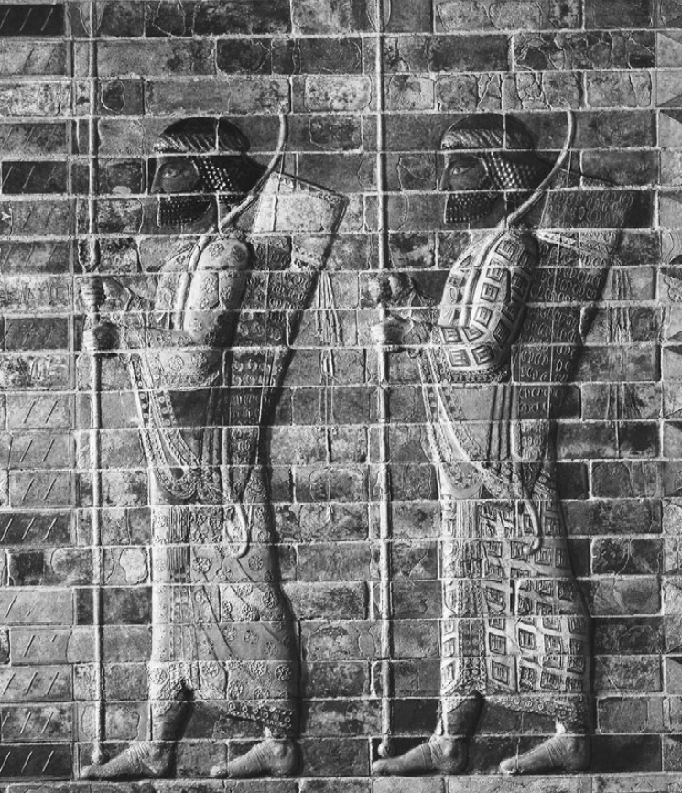
The 'Immortals', as the Greeks knew a Persian King's elite guard on campaign, depicted on glazed bricks from the Palace of Susa, Iran Erich Lessing/Art Resource, NY

Slide 11
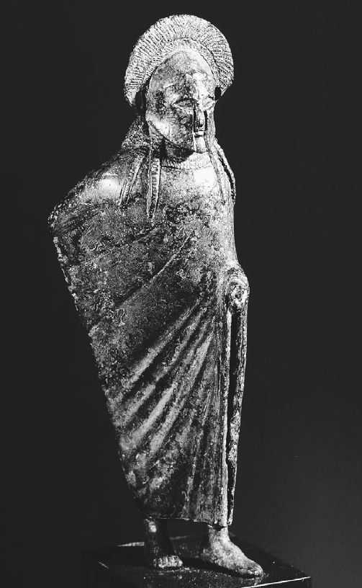
Small bronze figurine, 6th-century BCE, depicting a Spartan commander, possibly a king, wearing his characteristic (red) cloak Wadsworth Atheneum Museum of Art/Art Resource, NY

Slide 12
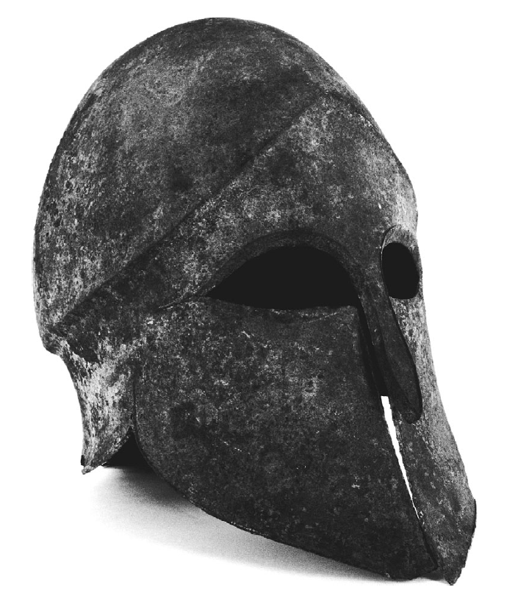
Bronze helmet of the 'Corinthian' (all-over) type, of the period of the Battle of Plataea © The Trustees of the British Museum

Slide 13
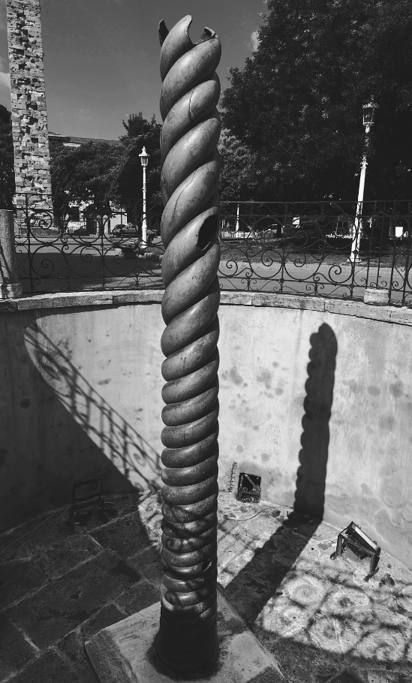
The official monument dedicated by the victorious Greeks to Apollo at Delphi (subsequently removed to Constantinople/Istanbul, where its partial remains subsist in the old Hippodrome) took the form of a triple-coiled, triple-headed snake, whence 'Serpent Column'; above the snakes' heads originally was perched a golden cauldron Vanni/Art Resource, NY

Slide 14
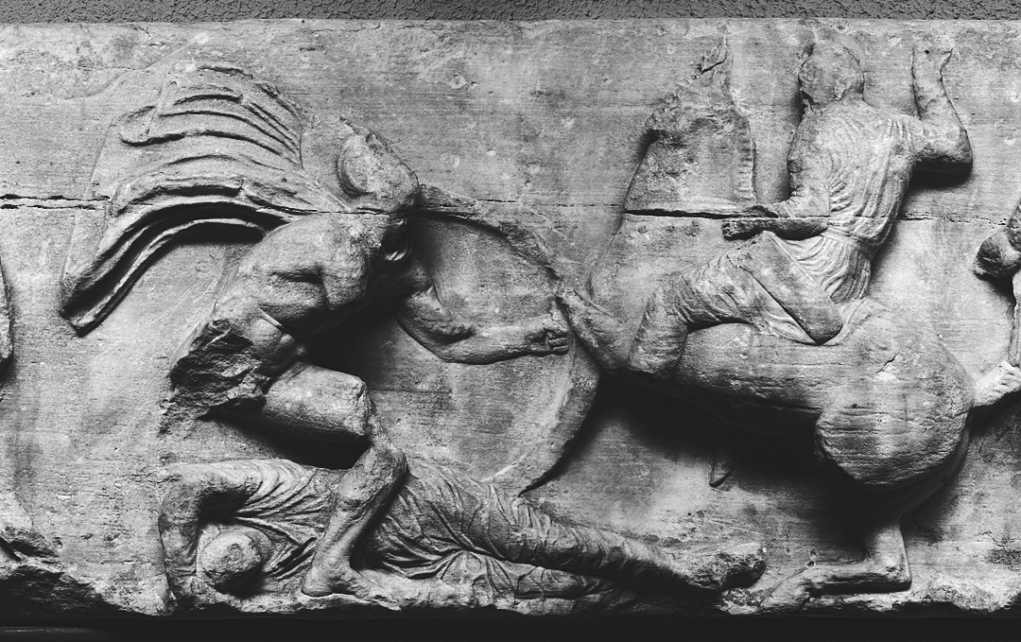
The Athenians' Temple of Athena Nike (Victory), c. 415/405 BCE, bore a relief frieze depicting a heroic victory of Athenians over Persians © The Trustees of the British Museum

