Slide 1
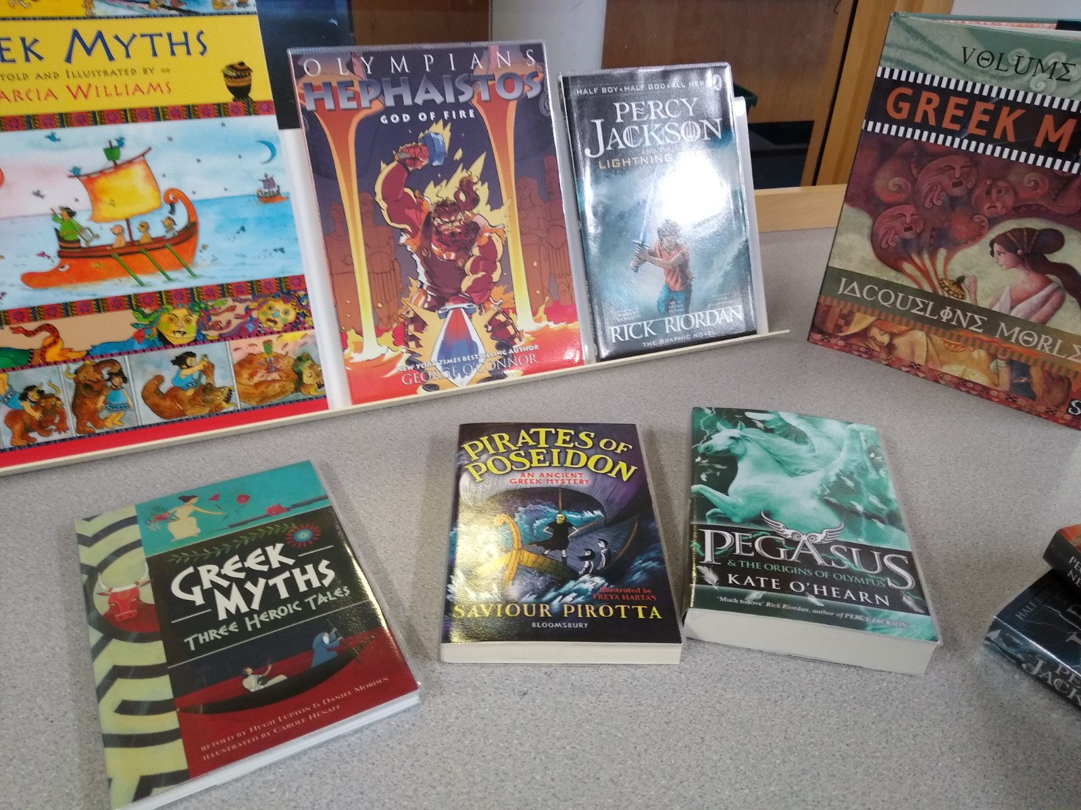
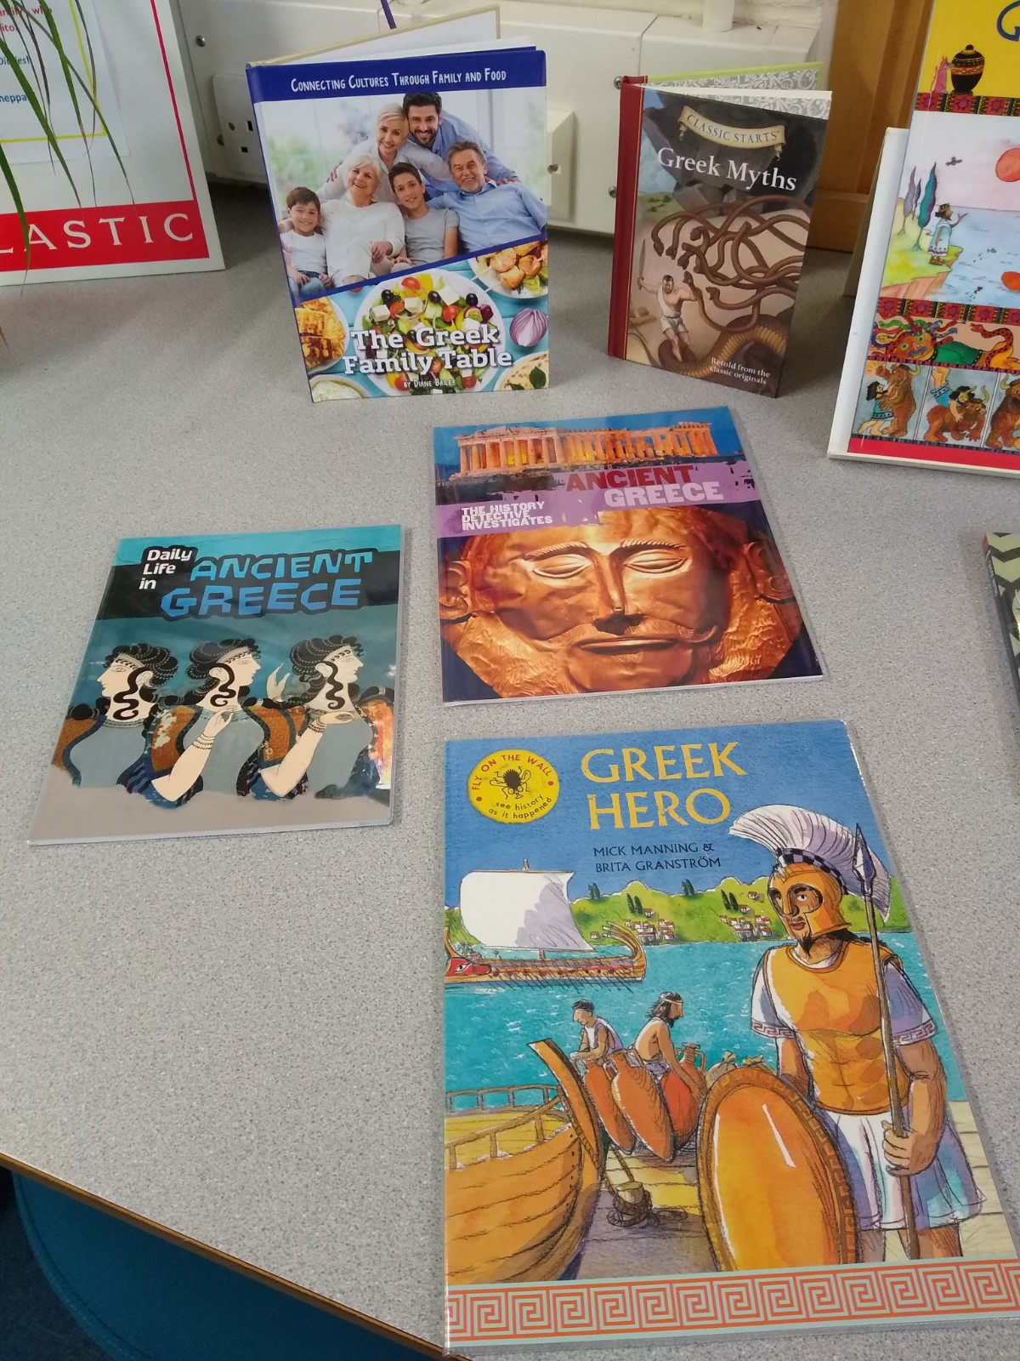
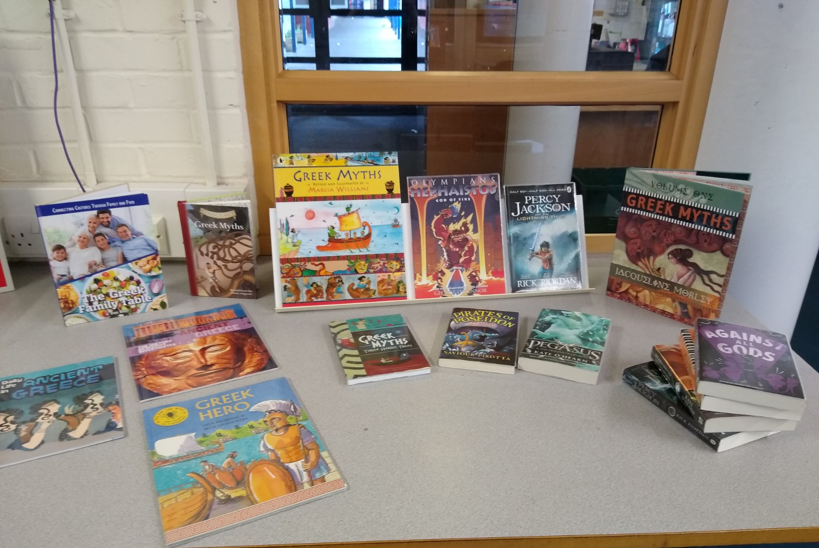
A selection of some of the books we have purchased for the library from your generous grant.
This includes Greek myths, new fiction based on Greek myths & books about Greek culture.

Slide 2
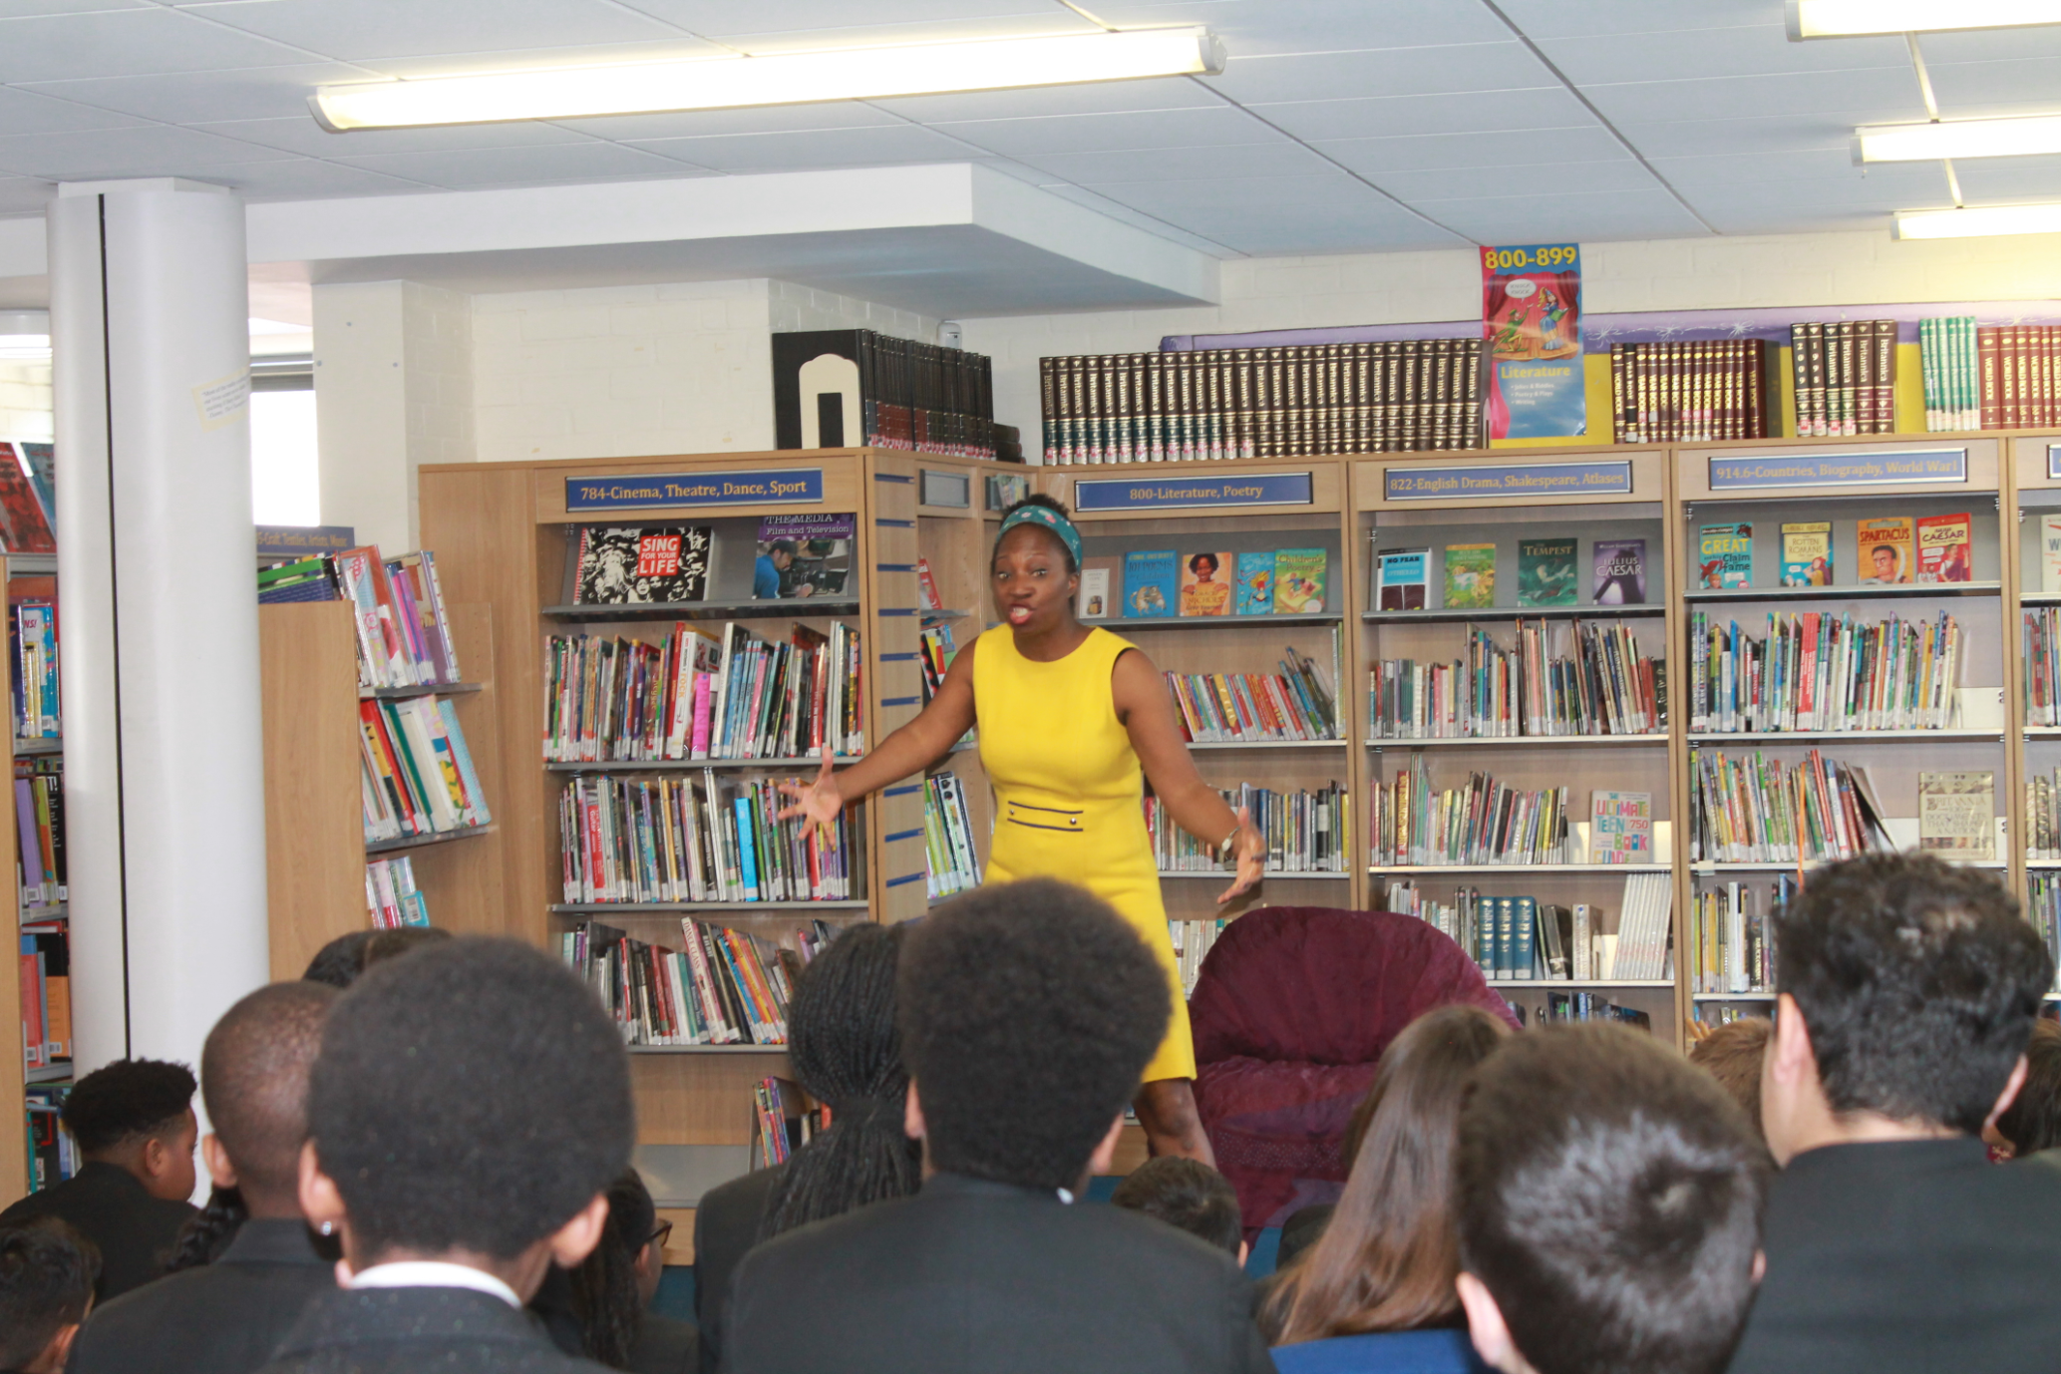
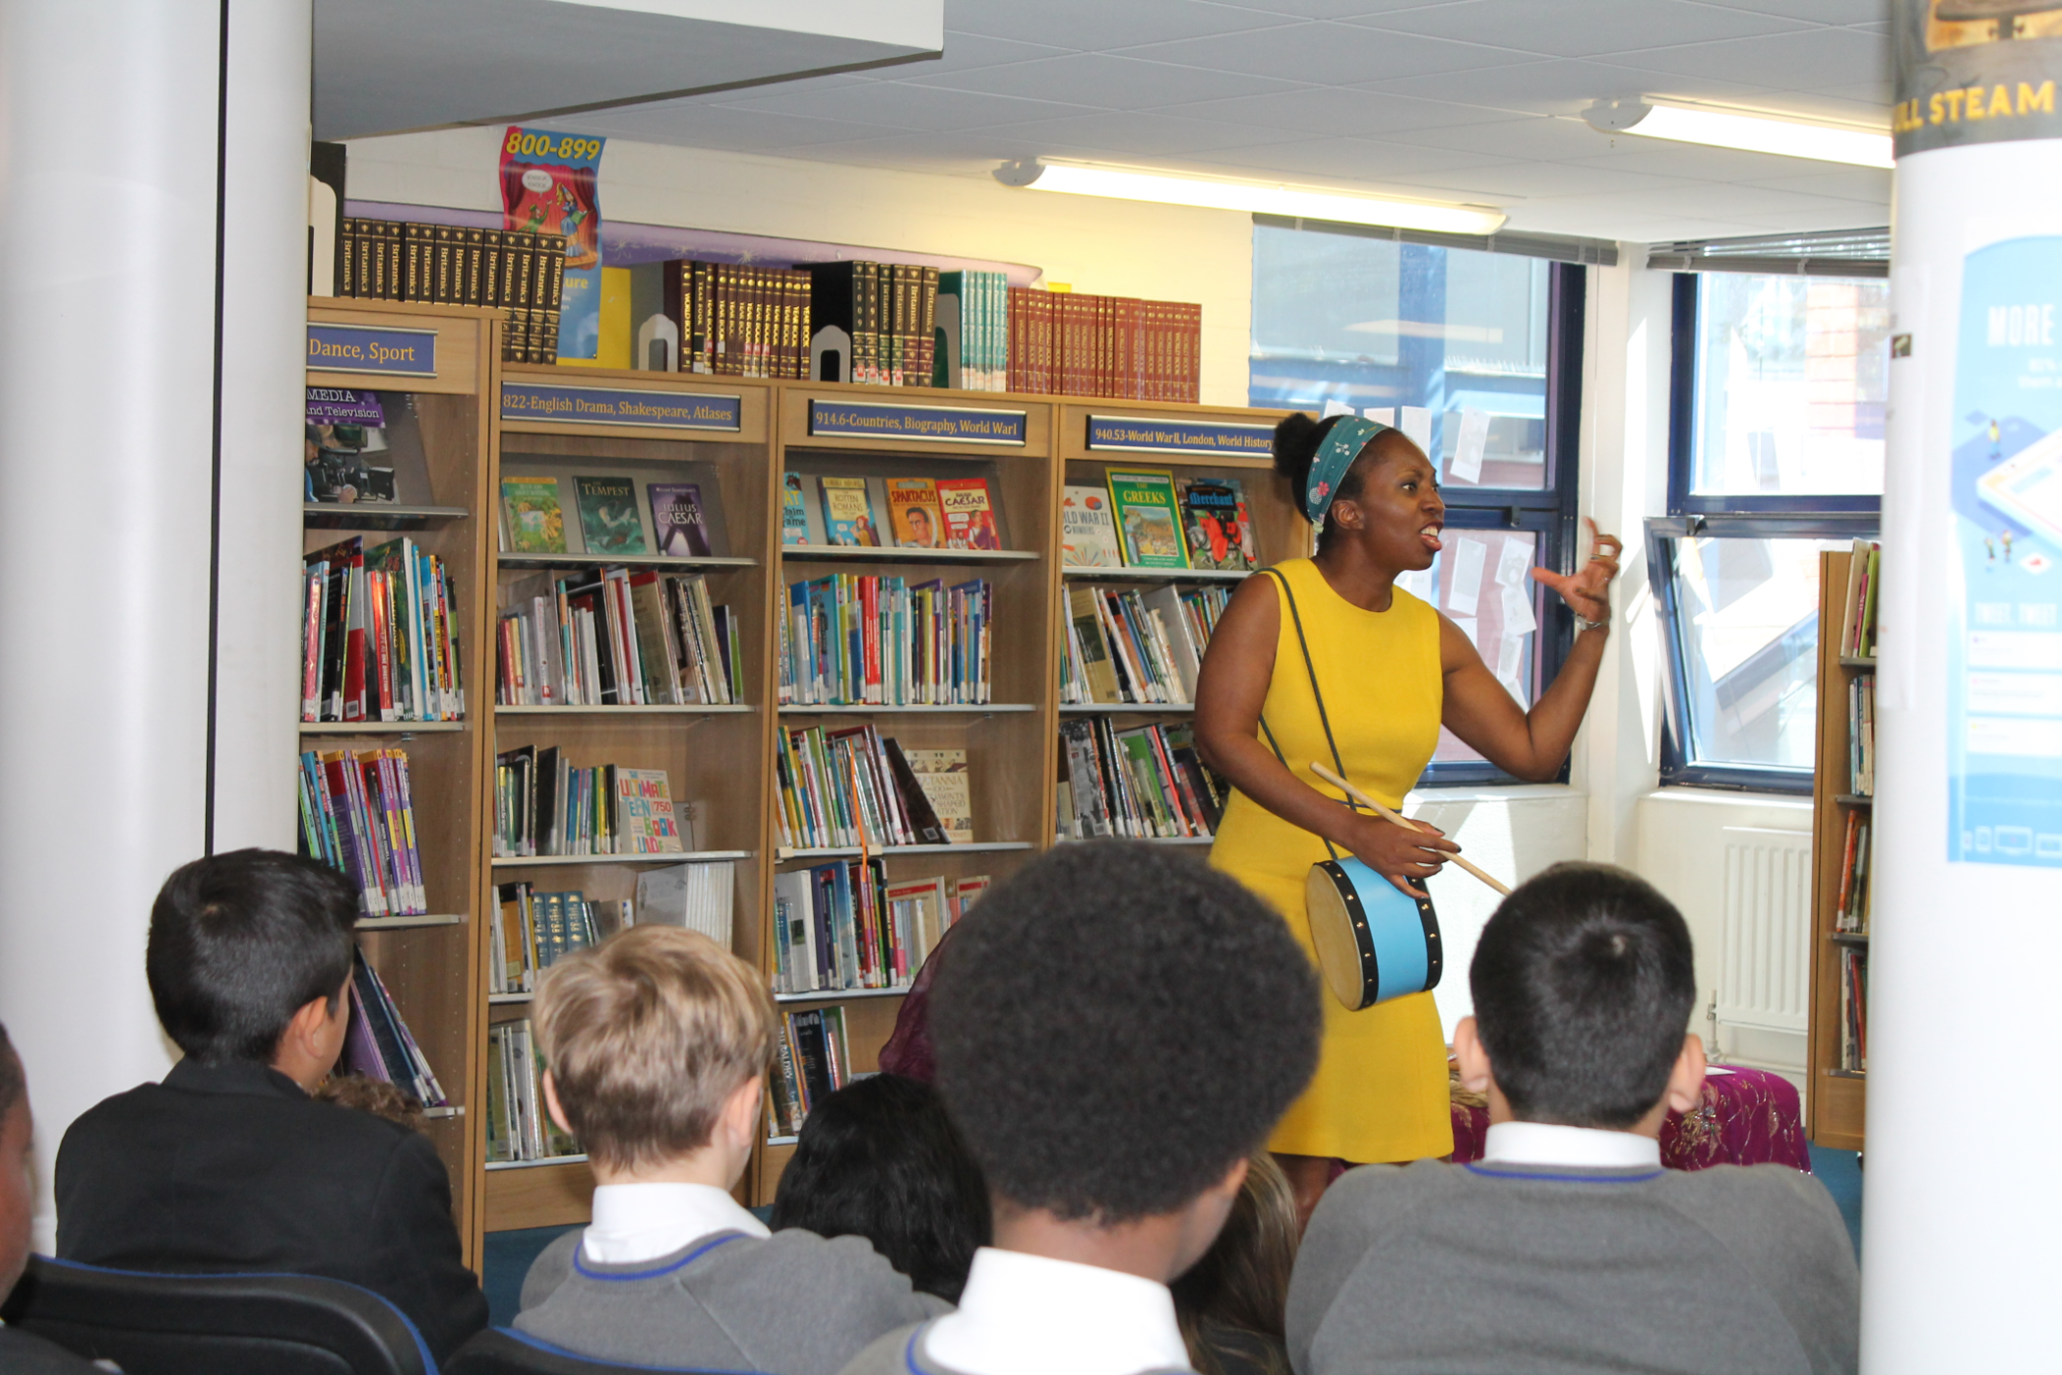
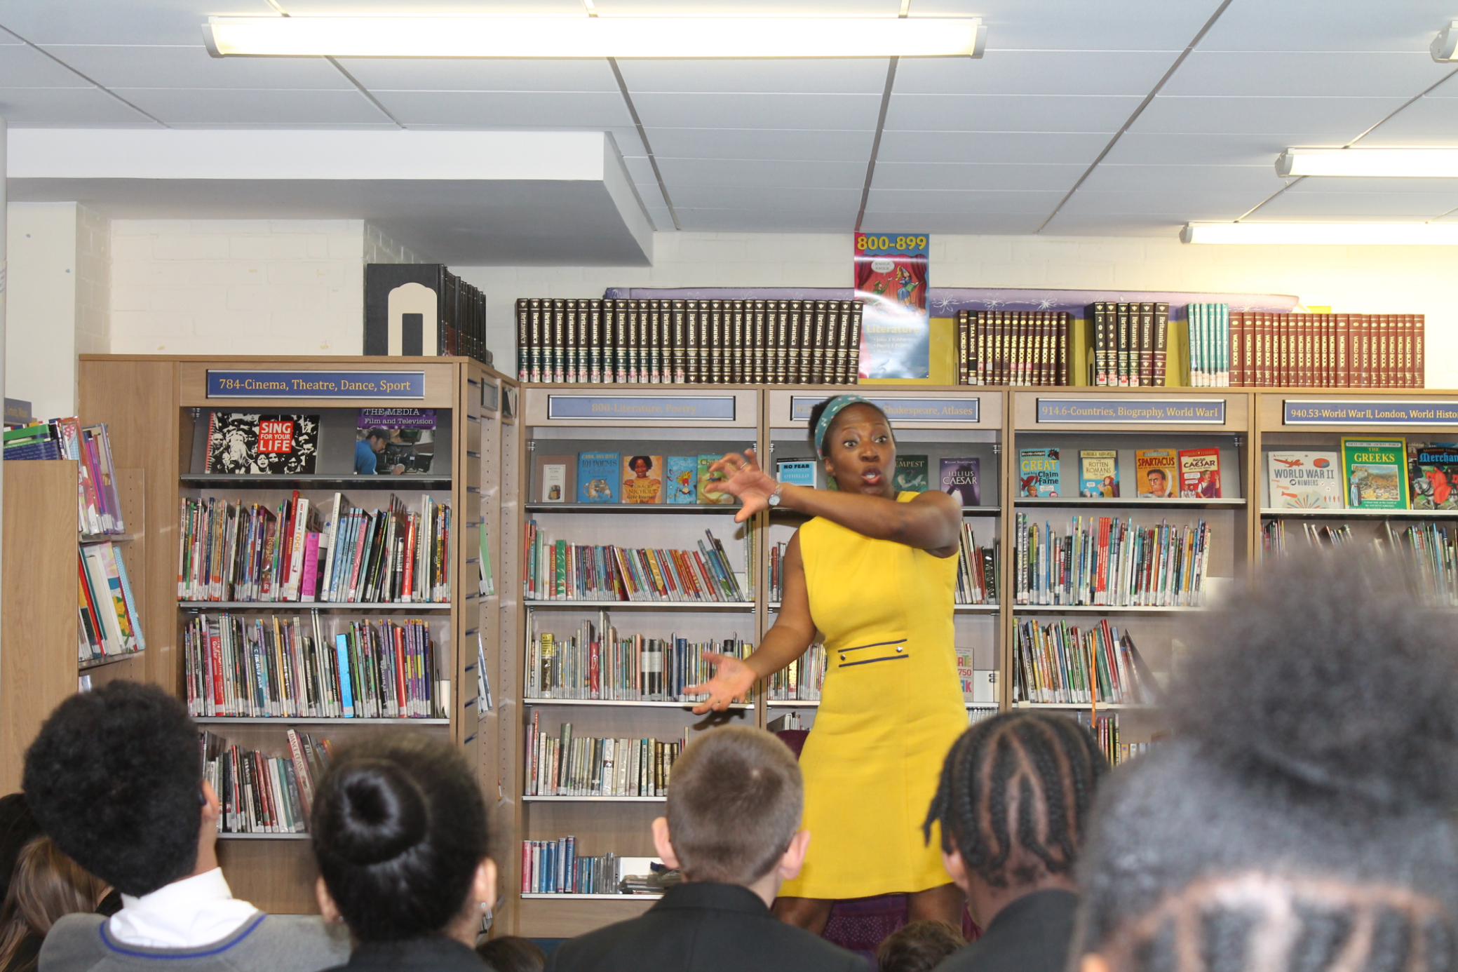
Local storyteller, Wendy Shearer (from StoryBoat Tales) tells some traditional Greek myths.

